Slide 1
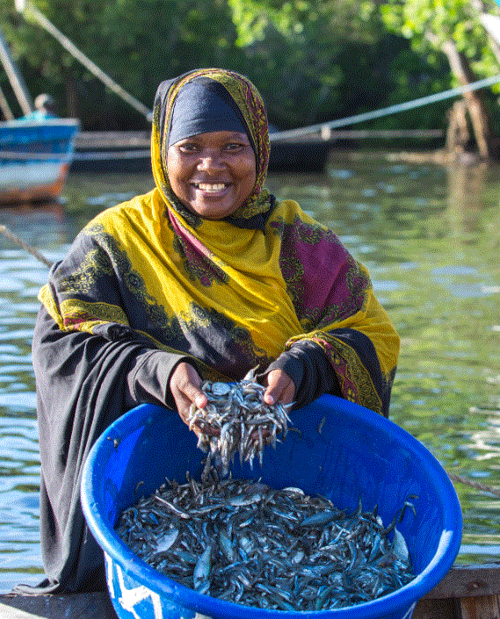
Unlocking the Female Economy: Leveraging Gender-Disaggregated Data for Inclusive Credit Growth
Presenters : Christine Waita (KBA) and
Sharon Juma (FSD Kenya).
19th August 2025

Slide 2
Agenda
Why funding women matters
The power of gender-disaggregated data
Kenya’s coalition approach
From data to products & policies
Expected impact

Slide 3
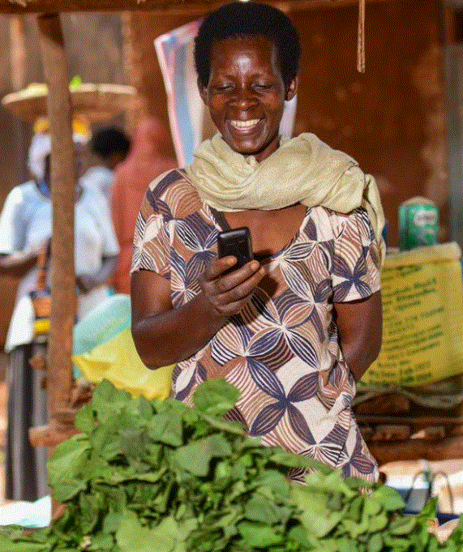
Why funding women matters

Slide 4

The Scope of the challenge…
Women in developing countries aspire to be entrepreneurs at similar rates as men
…yet they face significant
barriers
…that limit their ability to
realize their potential
Social norms (3-4 times free domestic labor), care burdens (KNBS)
Women own just 30% of agricultural land in SSA
75% of the legal rights as men (inheritance, property rights, GBV)
2X more loan rejections
< 2% of VC Funding to female teams
$1.7 trillion global financing gap, $42 billion in Africa.
25%
Fewer Women start businesses than men
36%
Gap in growth expectations between female and male entrepreneurs
$1.7 Trillion lost revenue opportunity for Financial Service Providers
~ 5.6 Trillion is lost in value addition globally
Source: WE Finance Code | Women Entrepreneurs Finance Initiative

Slide 5
The Kenyan Context…
Kenya has ~7.4 million MSMEs, forming 90% of the labor force (FSD Kenya).
MSMEs are the backbone of jobs and growth.
80% of MSMEs are unlicensed, restricting access to finance.
Women lead 61% of these unlicensed enterprises ,more excluded.
Women own about 52% of MSMEs but access only ~36% of formal credit (CIS Kenya).
This is despite women showing better repayment behavior (60+ DPD: 4% women vs. 5% men).
54.9% of women-owned MSMEs close within the first year, often due to funding gaps and gender-related barriers (KNBS).
Structural barriers
Rigid collateral requirements.
Lengthy, restrictive loan procedures and business registration.
Limited use of gender-disaggregated data in credit decision-making.

Slide 6
The power of gender-disaggregated data

Slide 7
Formal Access gender gap is closing, mainly driven by mobile money; but the formal/informal divide persists…
Account ownership by gender
% of adults 18+ (2006-2024)
Account ownership by type of account by gender
% of adults 18+ (2024)
Source: FinAccess 2024
Base: Male population= 13,648,460; Female population = 14,493,609

Slide 8
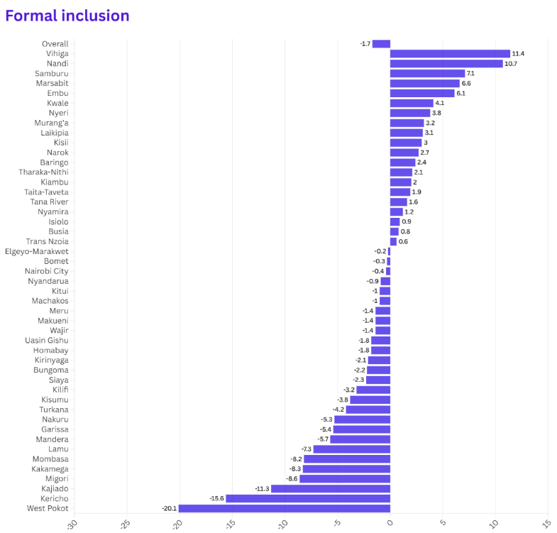
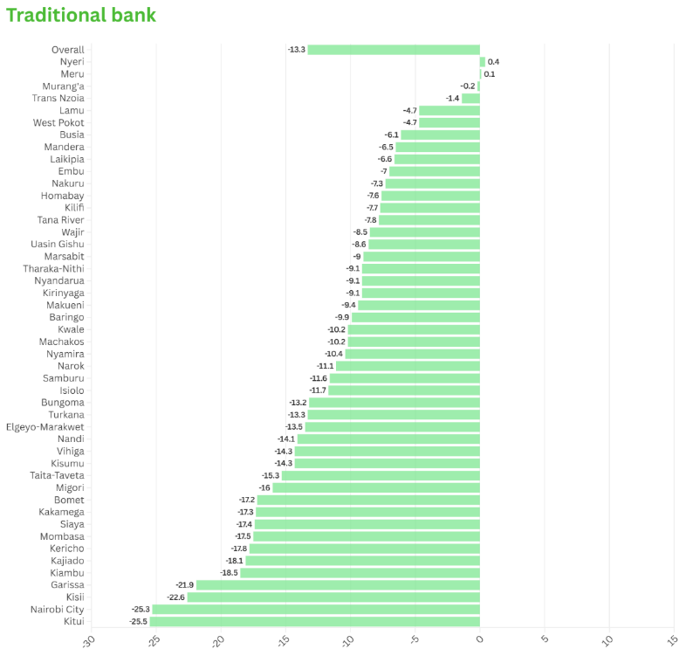
The Shape of the 2024 Gender Gap…
Formal financial inclusion gender gap
Traditional bank gender gap
Source: FinAccess 2024

Slide 9
More women business owners than men, the largest segments of business owners are aged between 26 – 35 years old...
BUSINESS OWNER SEGMENTS – GENDER AND AGE: 2024
(18+; main source of income is own business / self-employed, operational businesses)
3.77 Million:
Business owners with operational businesses
Female
Male
2.06 Mn
1.71 Mn
18 - 25
26 - 35
36 - 45
46+
18 - 25
26 - 35
36 - 45
46+
298k
791k
548k
427k
252k
666k
427k
363k
Notes:
FA2024 Tables 18+, Tab: Segments

Slide 10
Bank account: 27% of women with operational businesses have bank accounts compared 45.3% of men business owners
BUSINESS OWNER SEGMENTS – Bank account GENDER AND AGE: 2024
(18+; main source of income is own business / self-employed, operational businesses)
35.5% operational businesses have bank accounts
1.34 Million: with bank accounts
Business owners with operational businesses
Female
Male
565.6K
775.0K
18 - 25
26 - 35
36 - 45
46+
18 - 25
26 - 35
36 - 45
46+
63.1K
233.1k
148.4k
120.9k
101.8k
324.1k
194.3k
154.7k
Notes:
FA2024 Tables 18+, Tab: Segments

Slide 11
Male business owners have higher median monthly incomes…
MEDIAN MONTHLY INCOME OF BUSINESS OWNERS BY SEGMENT: 2024
(18+; 3.7 Million Operational Businesses)

Slide 12
How might we help women MSMEs with financial solutions for investing?

Slide 13
The impacts…women-led MSMEs often match or outperform men on repayment, yet receive smaller share of formal credit…
Source: CIS Kenya 2024

Slide 14
The Problem: The missing links in gender-smart finance…
Women-led MSMEs are invisible in most credit data
Gender-disaggregated MSME credit data rarely collected.
We can’t measure participation, performance, or growth patterns.
Without gender tags, a bank’s MSME book may look healthy overall, but it could be systematically under-serving women.
Visibility
Definitions and tagging differ across providers.
MSME and gender categories vary widely across banks, MFIs, SACCOs, fintechs.(Women owned, women led, women operated)
Hard to set sector targets or track progress. Banks can’t compare their performance to peers.
Comparability
Insights don’t reach decision-making.
Data often sits in reports , not linked to underwriting, product design, or pricing.-Lending Decisions
Lending decisions still based on legacy assumptions, not real performance data- Product Misfit
Missed opportunity for tailored, profitable growth. – 5-15% Growth
Actionability

Slide 15
Where We Began : The Theory of Change
Ultimate goals:
Increase in evidence-based public policies that support (Women) SMEs
Financial solutions designed to respond to the diverse needs of women and MSMEs
Increase in MSME-centric FSPs
Policymakers (CBK,SASRA)
Increase in number of policies and programs in place to support women MSMEs (improved regulatory and legal frameworks)
Mainstreaming of gender-disaggregated data collection and use
Improve harmonization of data and definitions e.g. definition of MSMEs
Policy-makers
Provide evidence to influence policy design
Set inclusive policies
Data aggregators KBA, AMFI
Improve the availability of gender-disaggregated data publicly at an aggregate level
Promote the use of data to develop women-centric solutions
Inform policy to set evidence-based inclusive policies
Women can access increased financing for their businesses
Entrepreneurs can thrive through increased access to business financing and support
Report data on MSMEs
Provide market data for product development & solution design
FSPs
Increased availability and use of gender-disaggregated data
Improved business decisions based on evidence
Increased interest in serving the WMSME segment
Expanded development of women-centric solutions
Adopted from work with FAW/CCX

Slide 16
CRB Integration…
Data Specification Template
KBA has opted to source raw, anonymized MSME data directly from Credit Reference Bureaus (CRBs) for the following reasons:
CRBs already receive standardized credit data from a wide group of FSPs; including banks, MFIs, SACCOs, and digital lenders.
CRB data offers a centralized, ready-to-analyze dataset, reducing duplication and speeding up insight generation.
Covers licensed & unlicensed MSMEs, includes proxy indicators to identify WMSMEs.
Use of a standard Data Specification Template (DST) ensures uniformity, allowing for robust dashboards and benchmarking.
Monthly data submissions and integration channels enable monthly updates, keeping the system dynamic and current.
MFIs
FinTechs
CRBs
SACCOs
Banks/MFBs
https://sites.google.com/usabledata.co/kba-wmsme/dashboards

Slide 17

What We Track in the KBA–CRB Gender-Disaggregated Dashboard.
Access & Uptake
Volume & Value
Portfolio Quality
Distributions
Loan applications by gender
Approval & acceptance rates
New-to-credit women borrowers
First-time formal borrowers.
Disbursements (number & value)
Active loan accounts
Average ticket size by sector/product
Loan purpose (working capital, asset finance, trade finance etc.)
Delinquency & NPL ratios by gender
Days-past-due distribution (30/60/90+)
Cure rates, restructures, write-offs
Loss-given-default comparisons
Lending by sector (trade, agriculture, manufacturing, services, ICT, etc.)
Gender split within each sector
Sectoral NPL trends by gender
Loan uptake by county/region
Performance by location (urban vs rural, county-by-county)

Slide 18

What We Track ..continued
Terms
Growth
Distributions
Tenor & repayment frequency
Collateral & guarantee usage
Alternative security instruments (group guarantees, movable assets)
Whether women who start with smaller loans are able to bigger loans.
How repeat borrowing works( are women rewarded with bigger limits after good repayment?)
Whether step-ups (increased loan sizes) are happening fairly between men and women.
Lending by sector (trade, agriculture, manufacturing, services, ICT, etc.)
Gender split within each sector
Sectoral NPL trends by gender
Loan uptake by county/region
Performance by location (urban vs rural, county-by-county)

Slide 19
Kenya’s coalition approach

Slide 20
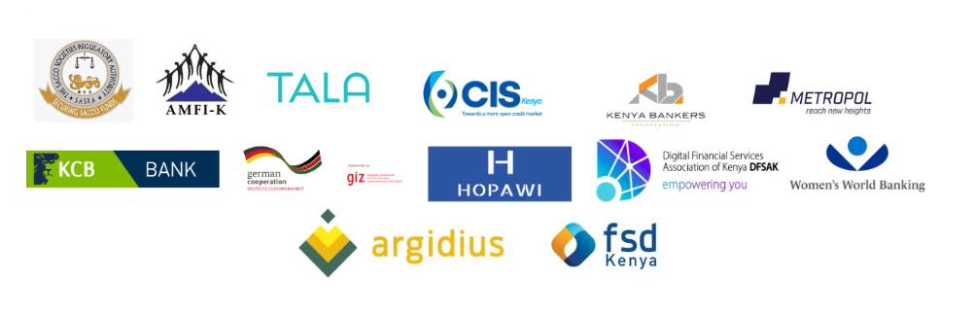




Kenya’s Coalition Approach …The WE Finance Code Kenya Chapter

Slide 21
Our journey so far…
Jan-Feb
March
May
July
Aug
Oct
Inception
Monthly Meetings
Regional Peer Learning
National Champion
Pre-Launch
Launch
1st Brainstorming Session.
Concept note developed
WE_FI working group developed.
Workplan developed
Sub working groups formed:
Advocacy and governance
Data and M&E
Brand and comms
Products and Design
A
Gender Learning Series by the FAW – Strategic Business case for serving WMSMEs
Kigali Summit and WE_FI study tour
CBK Selected as the National Champion for WE-FI code, Kenya Chapter.
WE_FI Kenya website created. (WE-FI Kenya)
Awareness workshop planned for 28th August.
WE-FI Code Kenya Launch

Slide 22

WE Finance Code …
What is the Women Entrepreneurs Finance Code (WE- Fi Code)? | A voluntary commitment by financial sector leaders to close the gender gap in access to finance for women-led businesses.
What does the Code entail? | The Core of the Code is a simple commitment in three areas Leadership: Public pledge from CEOs and boards to champion women’s financial inclusion. Designate a senior leader to drive the efforts to support women-led businesses. Data: Collect and report supply side sex-disaggregated MSME data to a national dashboard. Action: Use insights to design, pilot, and scale gender-smart products and services Develop new financial and non-financial services for W-MSMEs Increase volume of finance for W-MSMEs, inc. bonds, credit lines, equity, trade, etc. Establish business case, set targets, strategies, policies, standards to expand financing for women- led enterprises. Promote peer learning, document use cases.
Notes:
https://we-fi.org/wp-content/uploads/2024/10/WE-Finance-Code-Introduction.pdf

Slide 23
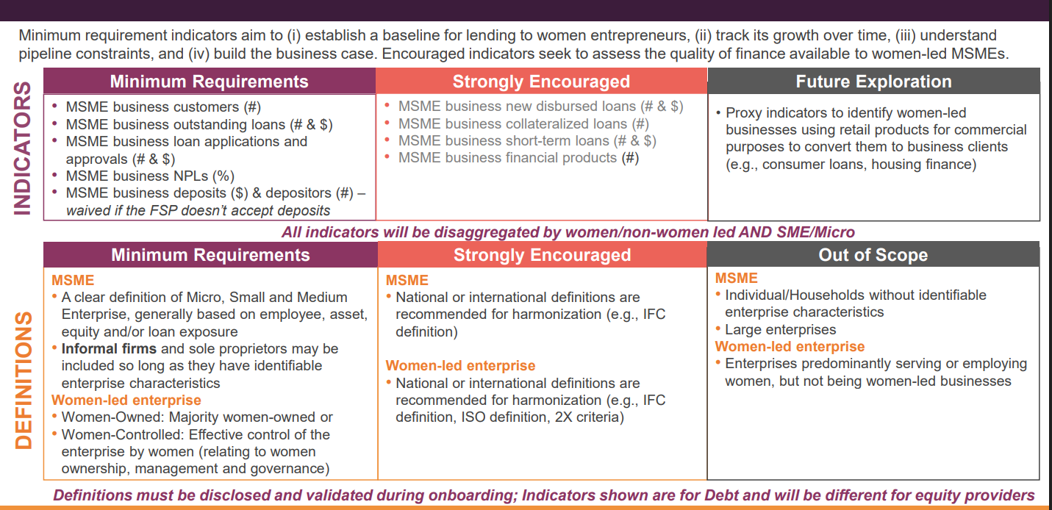
Indicators of interest…
Adapted from the WE finance Code secretariat - https://www.we-fi.org/we-finance-code/

Slide 24
From data to products & policies

Slide 25
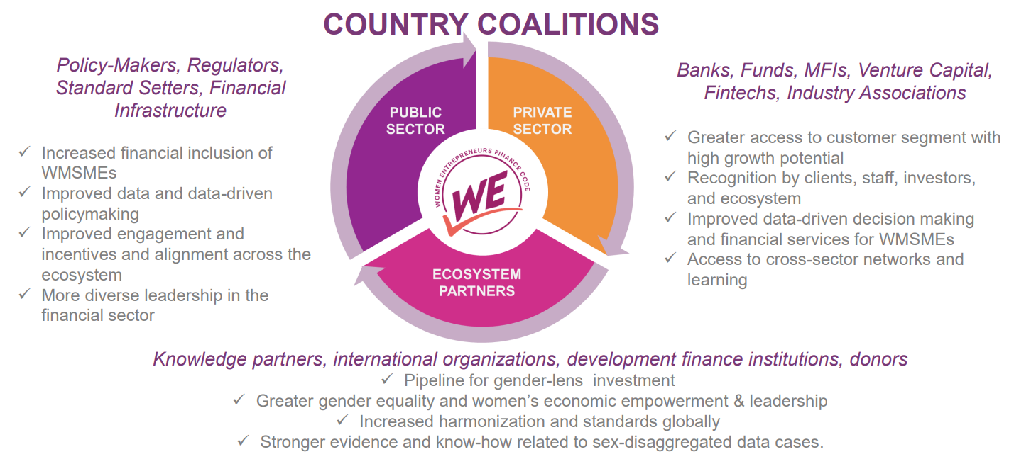
Benefits of being part of the WE Finance Code for Kenya
Adapted from the WE finance Code secretariat - https://www.we-fi.org/we-finance-code/

Slide 26
Women Entrepreneurs at the center of it all…
FSP’s
improve targeting of WMSMEs and produce baseline data
CHAMPIONS
DATA
Global partners
support peer learning, research, analysis & sharing good practices
Regulators
Take action to set definitions and data collection standards
Women Entrepreneurs Increase Capacity and Access Financing
Ecosystem Partners
with donor support build readiness and pipeline of women entrepreneurs
Investors & Donors
Blended Finance expand financing and TA to FSPs
ACTIONS

Slide 27
In summary, we have come together to leverage the WE Finance code to have a framework that will enable…
1. Dialogue & alignment
Enable structured conversations for better coordination and shared learning across stakeholders.
2. Data commitment
Commitments to collect, report, and use Gender- Dissagregated data to drive solutions.
3. Unite the sector
Bring together ecosystem players to drive the Code and intended WMSME outcomes collaboratively.
4. Define priorities & roadmap
Help shape clear timelines, priorities, and actions for Code adoption and action
5. Engage policymakers
Act as a platform to influence policies that support WMSME solutions

Slide 28


Thank You

